Slide 1
AI Algorithms I Project – team mavericks
Tech-Lead: Yash Shah 100768592 Team Member: Geethu Kannan 100801786 Team Member: Shraddha Khadepatil 100820094 Team Member: Varun Kadian 100820124 Team Member: Yash Halani 100848564

Slide 2
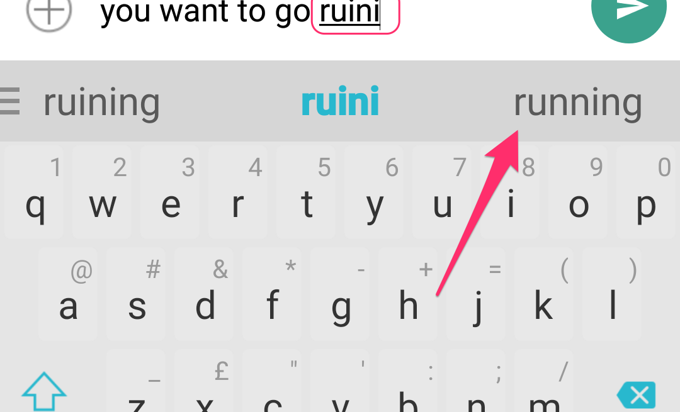
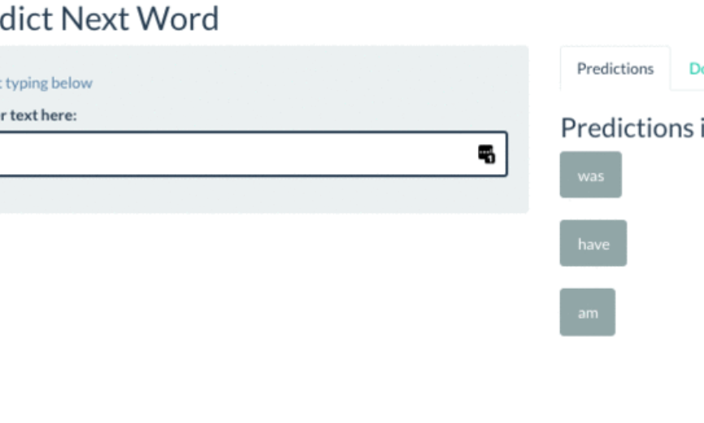
Next Word Predictor The task of predicting what word will come next
Data Collection
Prepare and Pre-process the data
Model the data
Train and Test the model
Verify and Deploy the Model

Slide 3
Technologies to be used
Model Development: Python
Web Development: Flask
Application Deployment: Heroku

Slide 4
Data Requirements and sources
Data Requirements:
Any dataset with conversations, chats with different contexts.
Data Source:
Pre-trained BERT transformer model consisting of pre-defined NLP data.

Slide 5
Test Process
Unit Testing: Individual components are tested.
Integration Testing: Component groups are tested.
System Testing: Integrated system is tested to meet system requirements.
Acceptance Testing: Whole system is tested in compliance of the business requirements.

